Slide 1

Module 5 – Advanced Analytics on Big Algorithm Usage- Problem

Slide 2

Advanced Analytics on Big Data
Machine Learning algorithms at scale
Consider the list of machine learning applications down. Which use supervised learning, and which use unsupervised learning?
In Google News, grouping together similar articles
Determining if a particular credit card transaction is fraudulent
Analyzing an image to determine if a lump is cancerous
Recommending a product based on what the user buys
Market segmentation: dividing customers into various groups

Slide 3
Advanced Analytics on Big Data
Machine Learning algorithms at Scale
In Google News, grouping together similar articles unsupervised
Determining if a particular credit card transaction is fraudulent supervised
Analyzing an image to determine if a lump is cancerous supervised
Recommending a product based on what the user buys unsupervised
Market segmentation: dividing customers into various groups either depending on whether we already have pre-defined groups or not

Slide 4
Advanced Analytics on Big Data
Among them which project should be approached in Supervised Model building?
speech recognition
handwriting recognition
bio metric identification
document classification

Slide 5

Advanced Analytics on Big Data
One More Question
You want to write a program to separate out the rocks into different categories

Slide 6
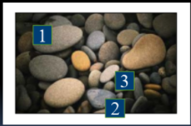
Advanced Analytics on Big Data
Supervised
We define the concepts we want the computer to learn
Consider the photograph of Pebbles on the right
We can input examples of each kind of the pebble
Pebble 1 Large
Pebble 2 Medium
Pebble 3 Small
The program will learn to classify images

Slide 7
Advanced Analytics on Big Data
UnSupervised
The program
computes various features of the Pebbles
Groups similar Pebbles Together
Its own classification of Pebbles
These may be different from the way a human being would classify them
The same program can come up with different classification if we change some parameters
3 or 4 groups

Slide 8
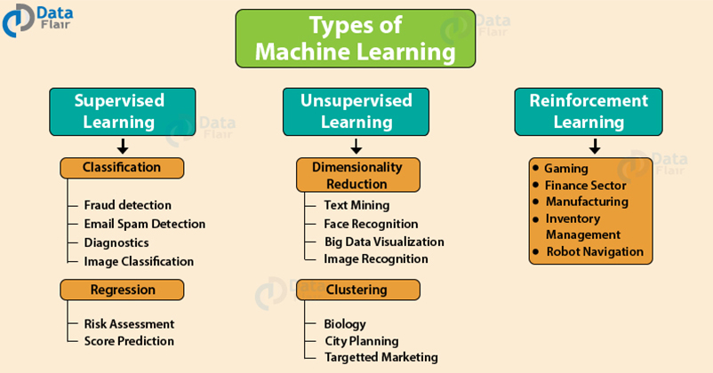
Advanced Analytics on Big Data
Algorithm Classification

Slide 9
Advanced Analytics on Big Data
Classification Algorithms
Logistic Regression
Naives Bayes
Decision Tree
K-Nearest Neighbour
SVM
Random Forest
Stochastic Gradient
Kernel Approximation

Slide 10
Advanced Analytics on Big Data
Regression Algorithms
Neural Network
Decision Tree
LASSO
Ridge
Elastic Net

Slide 11
Advanced Analytics on Big Data
Dimensionality Reduction Algorithms
PCA
Singular Value Decomposition

Slide 12
Advanced Analytics on Big Data
Clustering Algorithms
Affinity Propagation
Agglomerative Clustering
BIRCH
DBSCAN
K-Means
Mini-Batch K-Means
Mean Shift
OPTICS
Spectral Clustering
Mixture of Gaussians

Slide 13
Advanced Analytics on Big Data
Algorithm Classification

Slide 14
Advanced Analytics on Big Data
Summary
Exposed to different algorithms
based on learning
How to scale these algorithms
to do Big Data Analytics?

Slide 15
THANK YOU

